Slide 1

Tales from the Trenches
Taming 20 years of Legacy Code
Joel Hammond-Turner
E: joel@hammond-turner.org.uk
T: @Rammesses
Notes:
INTRODUCTION: 00:03:00 (03.00)
Introduce yourself
Introduce Landmark
Reminder: We’re recruiting!
Frame the talk
So many possibilities
Also 1st run out – be nice!
Questions as we go

Slide 2

Prologue: A Product in Peril
Notes:
PROLOGUE: 00:10:00 (07.00)
Talk about coming into the team as the 3rd tech lead in 3 years
- Was it a sideways push? Away from the real action?
Legacy codebases just aren’t SEXY!
A million lines of code
30 years of history
None of the original developers in the team
Convoluted deployment processes… split personality between the software and the scripting.

Slide 3
Prologue: A Product in Peril
Winforms
ASMX
SQL Server
Client
Server
Database
Notes:
PROLOGUE: 00:10:00 (07.00)
Describe the basic structure of the core app – traditional client server

Slide 4


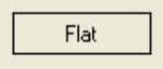
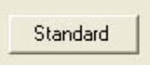



“Just quickly change those buttons…”
Notes:
PROLOGUE: 00:10:00 (03.00)

Slide 5
How to spot the symptoms?
Fear of change to the codebase
Excessive PR size
Excessive time to make small changes
“Extensive” backlogs
“Difficult” onboarding process
Custom implementations
Threading!
WTF/min rate
Notes:
PROLOGUE: 00:10:00 (03.00)

Slide 6

Chapter 1: The Legacy of Global Evil
Notes:
CHAPTER 1 : 00:35:00 (25.00)
Talk about the structure of a “traditional” WinForms app

Slide 7

The History of a God (object)
Program.cs
Footer.cs
MainForm.cs
Header.cs
Content.cs
ListTab.cs
CaseDetailTab.cs
AppHelper.cs
HeaderHelper.cs
FooterHelper.cs
Notes:
CHAPTER 1 : 00:35:00 (25.00)
Discuss how easy it to “need” to either pass pointers down, or else cross-connect components

Slide 8
“Aim for its heart!”
Program.cs
Footer.cs
MainForm.cs
Header.cs
Content.cs
ListTab.cs
CaseDetailTab.cs
AppHelper.cs
HeaderHelper.cs
FooterHelper.cs
Notes:
CHAPTER 1 : 00:35:00 (25.00)
Talk about the Client Shell class in the context of a “traditional” WinForms app
Discuss the use of global “god” objects – as ServiceLocators / Helper pointers, etc

Slide 9
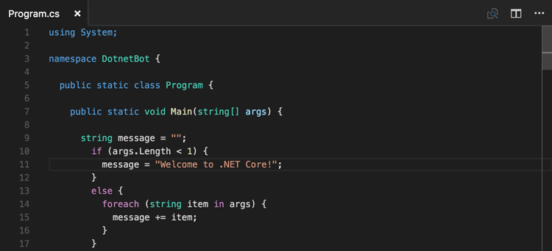
Show me some code!
Notes:
CHAPTER 1 : 00:35:00 (25.00)
Show how MSDI can be added at the root of a WinForms project as a more useful “god” object
Show how a quick and dirty Lazy / ServiceLocator pattern provides a way to remove god object references
Show how background services can be easily extracted
Discuss use of Views / ViewModels / Components

Slide 10
Slaying Cthulu
Identify the worst offenders
Extract “behaviours” into services
“Inject” services using DI
Lazy Factories with ServiceLocator
Notes:
CHAPTER 1 : 00:35:00 (25.00)
Explain how refactoring the Client shell provides an obvious reference implementation
Best starting place for refactoring views.

Slide 11

Notes:
INTERMISSION: 00:45:00 (10.00)

Slide 12
Tales from the Trenches
Taming 20 years of Legacy Code
Joel Hammond-Turner
E: joel@hammond-turner.org.uk
T: @Rammesses
Notes:
WELCOME BACK 00:46:00 (01.00)
Remind that we were looking at internally modernising the app

Slide 13
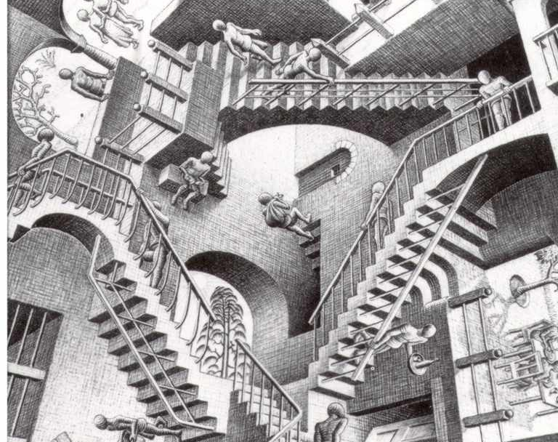
Chapter 2: The Mountains of Reference Madness
Notes:
Chapter 2: 01:00:00 (14.00)

Slide 14
Cycling in Spaghetti
ScriptEngine.cs
ScriptInvoker.cs
Dispatcher.cs
MacroInvoker.cs
CommandHandler.cs
Notes:
Chapter 2: 01:00:00 (14.00)
WAS going to talk about spaghetti code
Reference the script engine as a particular example!

Slide 15

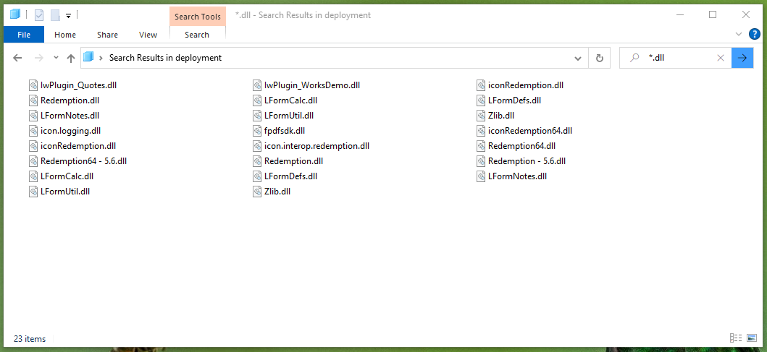
Surprises where you least expect them
Notes:
Chapter 2: 01:00:00 (14.00)
A more pernicious problem…
Talk about the problems of
Embedded DLLs
Identifying and removing them

Slide 16
Dizzying Connections
Client
ClientCore
Logging.Abstractions (NuGet)
Office.dll
FrameworkCore
Notes:
Chapter 2: 01:00:00 (14.00)
Talk about…
Cross-solution / cross project references
How SDK project migration fixed this
The fallacy of building into a single folder
Project references – good
Nuget dependencies – good
DLLs in source repo – bad
Cross-solution direct dll references – worse!

Slide 17
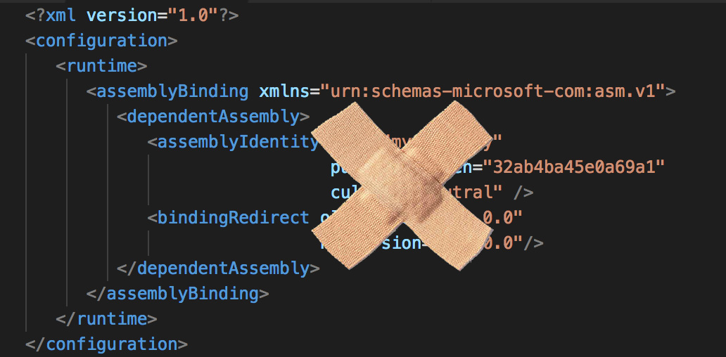
Bind me unto Death
Binding redirects fix conflicts…
Notes:
Chapter 2: 01:00:00 (14.00)
Fixing package updates / project references WILL cause binding conflicts…
Discuss how the lack of app.config in the client caused problems with System.Net.Http library updates

Slide 18
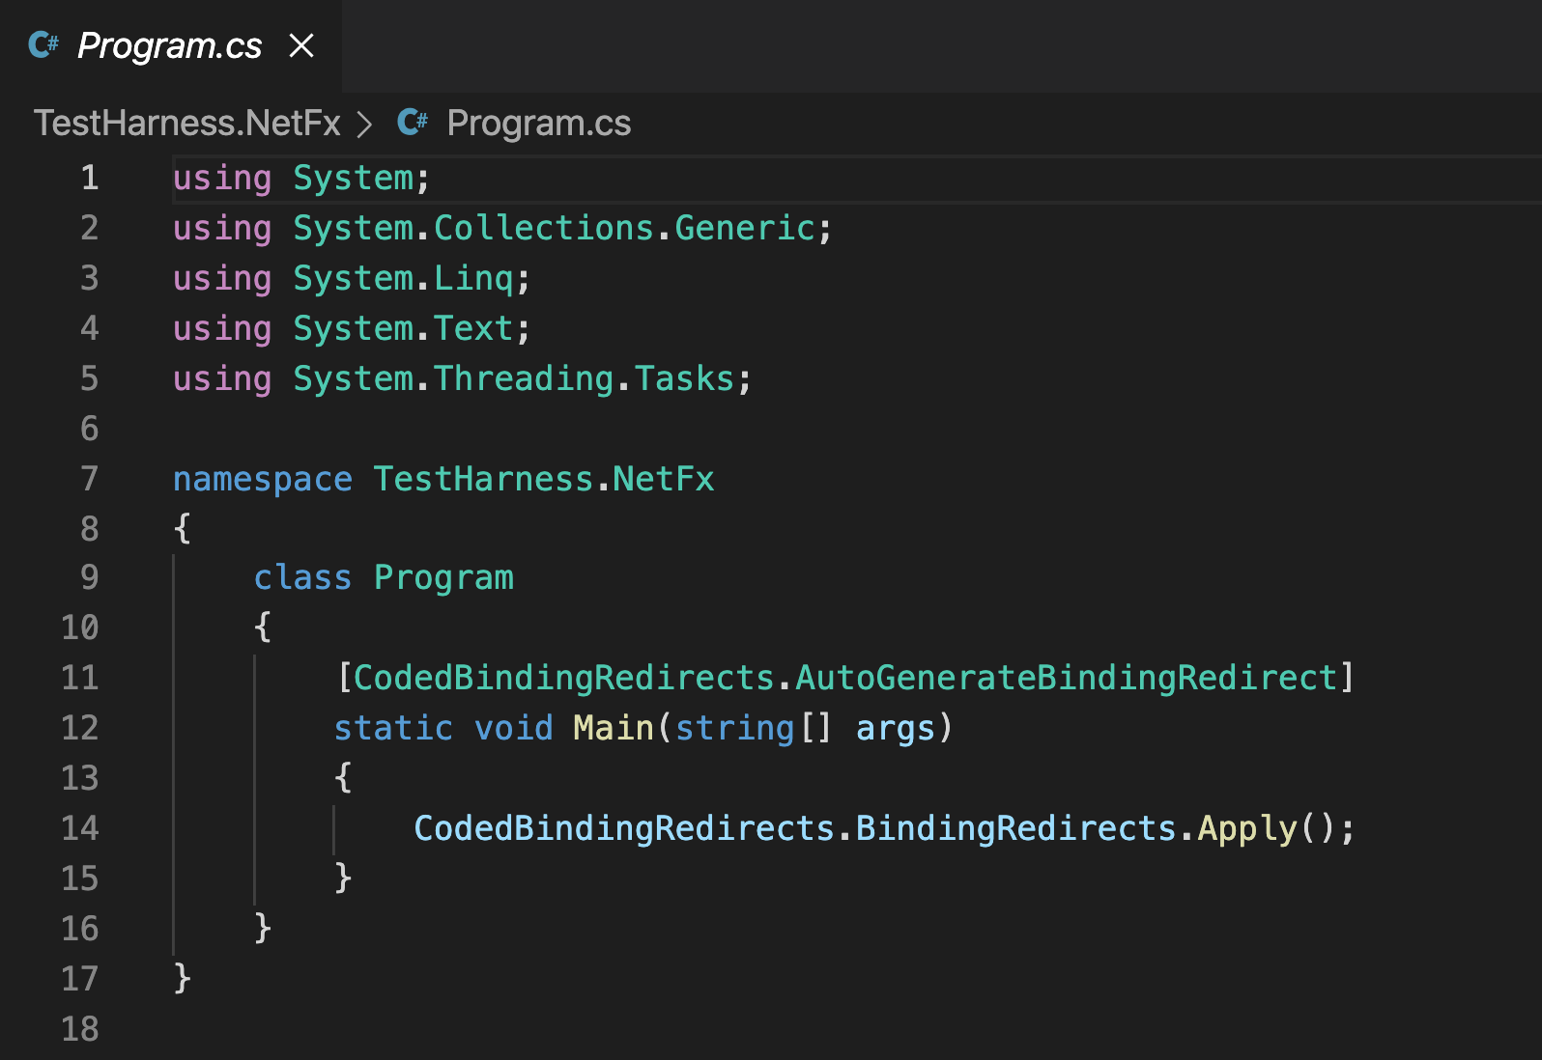
Show me some code!
Notes:
Chapter 2: 01:00:00 (14.00)
Show the CBR demo code – show the _generated_ code.

Slide 19
No easy solution
DLLs in source control
JUST SAY NO!
Remove anything that’s not a package or project reference
Migrate to SDK format project files
Binding redirects don’t have to be painful! ☺
Notes:
Chapter 2: 01:00:00 (14.00)

Slide 20

Chapter 3: The Curse of ConfigurationManager
Registry Settings
App.Config
Database Config
Registry Loader
Configuration Manager
Database Loader
Configuration.cs
Feature1
Feature2
Feature3
Notes:
CHAPTER 3: 01:13:00 (13.00)
Explain why this is an anti-pattern –
Magic strings everywhere
Explain the rationale for the central configuration class

Slide 21
A Pattern of Options
Registry Settings
App.Config
Database Config
Microsoft.Extensions.Configuration
Feature1Config
Feature2Config
Feature3Config
Feature1
Feature2
Feature3
Notes:
CHAPTER 3: 01:13:00 (13.00)
Discuss why the Options pattern helps
Demo how Azure Configuration works with it.

Slide 22
One Connection to Rule Them
Azure App Configuration
One connection string
Configuration (key/value)
Secrets
From Key Vault
Feature Switches
Notes:
CHAPTER 3: 01:13:00 (13.00)

Slide 23
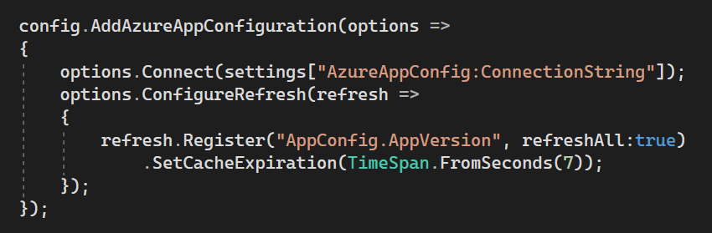
Show me some code!
Notes:
CHAPTER 3: 01:13:00 (13.00)

Slide 24

Appendix 1: Other Lurking Horrors
Hand-crafted “secure” web protocol
Table-data based
Shared “encryption” keys
Inverted naming – classic C style
File-based logging
At least 3 implementations!
Notes:
APPENDIX 1: 01:15:00 (02.00)

Slide 25

Postscript: How hard can it be?

Slide 26
Key Lessons
Spot the symptoms!
Refactor! Refactor! Refactor!
Understand the history of the codebase
Don’t just swear at it!
Spot patterns (good and bad)
Target for maximum reward

Slide 27
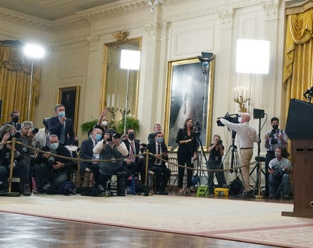
Questions?

Slide 28
Tales from the Trenches
Taming 20 years of Legacy Code
Joel Hammond-Turner
E: joel@hammond-turner.org.uk
T: @Rammesses

